Slide 1
These are the Required Installation in your system to develop this project.
VS Code installation: Youtube video link
https://www.youtube.com/watch?v=cu_ykIfBprI
Python installation: Youtube video link
https://www.youtube.com/watch?v=ddGTXBhaGWA

Slide 2
This is an 8 weeks Project
Project: AI Enabled Recommendation Engine for an E-commerce Platform

Slide 3
What is recommendation system
A recommendation system is an AI system that predicts what a user will like. It learns from user activity, browsing, purchases, and item similarities. Then it shows personalized suggestions like Amazon’s product list or Netflix’s movie list.
A recommendation system is an AI system that learns what a user likes and suggests items that they are most likely to buy, watch, read, or enjoy
Real-Life Examples
Use examples everyone understands:
Amazon suggesting products
Netflix recommending movies
Spotify giving song playlists
YouTube suggesting videos
Nykaa/Myntra showing personalized products
Make it relatable:
“When you search once for shoes, suddenly you start seeing shoe recommendations everywhere — that’s the recommendation system at work.”

Slide 4
Why Do Companies Use Recommendation Systems?
Explain the purpose:
To increase sales
To improve user experience
To keep users engaged for longer
To show relevant content instead of random items
Example:
Netflix says 80% of movies watched come from recommendations.
What Inputs Do Recommendation Systems Use?
Tell them what data goes in:
User's past purchases
Browsing history
Ratings & reviews
Items clicked or added to cart
Similar users’ behavior
Item characteristics (price, category, brand, etc.)

Slide 5
Output of the System
What does the recommendation system produce?
“Recommended for You”
“Because you watched…”
“People who bought this also bought…”
“Top picks for you”
“Our project will do the same: learn user preferences and recommend products in an e-commerce dataset.

Slide 6
Project Goal — Explanation
1. Start With the Main Goal
“The goal of our project is to build an AI system that recommends the best products to a user in an e-commerce platform.”
Explain it simply:
If a user likes mobile phones, the model should show similar mobiles.
If someone buys skincare items, the model should show related beauty products.
2. What Data We Will Use
“We will use two types of data:
1. User behavior data
What users clicked
What they viewed
What they added to cart
What they purchased
Ratings or reviews
2. Product data
Category
Brand
Description
Price
Features (size, color, specs, etc.)”
This helps students understand where the intelligence comes from.

Slide 7
Two Main Approaches We Will Learn
Explain the two ML approaches used in recommendation systems:
A. Content-Based Filtering
Recommends items similar to what the user has liked before
Uses item features (category, brand, description)
Example:
If a user liked a Samsung phone, the system recommends other Samsung or similar phones.
Tell them:
“The model focuses on the item content to find similar items.”
B. Collaborative Filtering
Recommends items based on similar users
Looks at patterns in user behavior
Example:
“If User A and User B watch similar movies, and A liked a new movie, we recommend it to B.”
Tell students:
“This approach does not depend on item features, but on user–user or item–item relationships.”

Slide 8
These are the basics which should know before developing this project.
Artificial intelligence (AI) is the field of technology and computer science focused on creating systems—such as computers or robots—that can perform tasks typically associated with human intelligence. These tasks include learning from data, reasoning, problem-solving, perception, making decisions, understanding language, recognizing images or speech, and more.
AI is used across a wide range of modern applications: from recommendation engines (like those in Netflix or Amazon), to virtual assistants (such as Siri and Alexa), chatbots, self-driving cars, image analysis in healthcare, fraud detection in finance, and much more.
AI is essentially about machines being able to “think” or solve problems in ways that were previously only possible for humans.

Slide 9
One Technique that creates the most impact in the domain of AI that is Machine Learning.
Machine Learning means That we give so much data to any mathematical or statical algorithm and our goal is that the particular algorithm can get the pattern from the data so that if we provide them to new data then it can be able to do some prediction.
In Machine learning, we can create 3-4 types of model.
A model which can predict numbers, basically regression problem. Eg. A model can predict the tomorrow's stock price of a company?
Classification problem model. Eg. A model can predict that in the picture there is cat or a dog?
Recommendation system.
But, Never machine learning was used there need of human creativity was felt. But, after Generative AI this thing has been changed what is the biggest main difference with GEN AI is that it can create new data as text, images etc. So, it has the capability of mimick the human creativity.

Slide 10
What is GENAI?
Gen AI is a type of artificial intelligence that creates new content - such as text, images, music or code - by learning patterns from existing data, mimicking human creativity.
GEN AI significant Impact areas:
Customer Support, eg. Chatbot for customer handling
Content Creation eg. It can create new content, any text based, video based.
Education eg. After chatgpt our learning pattern has changed. Now everyone has their personal tutor.
Software development eg. Generative models are really good in writing production ready codes.
Generative AI is successful technology or not?
Does it solve real world problems? Yes
As it is use for customer handling which is a problem of many companies.
And, everyone now is getting their personal tutor.
Is it useful on daily basis? Yes
Yes the tools we have in gen ai we use daily and we are getting profit from that.

Slide 11
What is an LLM?
LLM = Large Language Model
It is a type of AI system that can understand and generate human language (like English, Hindi, etc.) just by learning from huge amounts of text.
Think of an LLM as:
A super-advanced autocomplete that learned from books, websites, conversations, and documents to understand how humans communicate.
A Large Language Model (LLM) is an artificial intelligence system that learns from huge amounts of text and can understand language, complete sentences, and predict the next word or set of words in a meaningful way.
LLM is an AI that predicts the next words intelligently to generate human-like text.

Slide 12
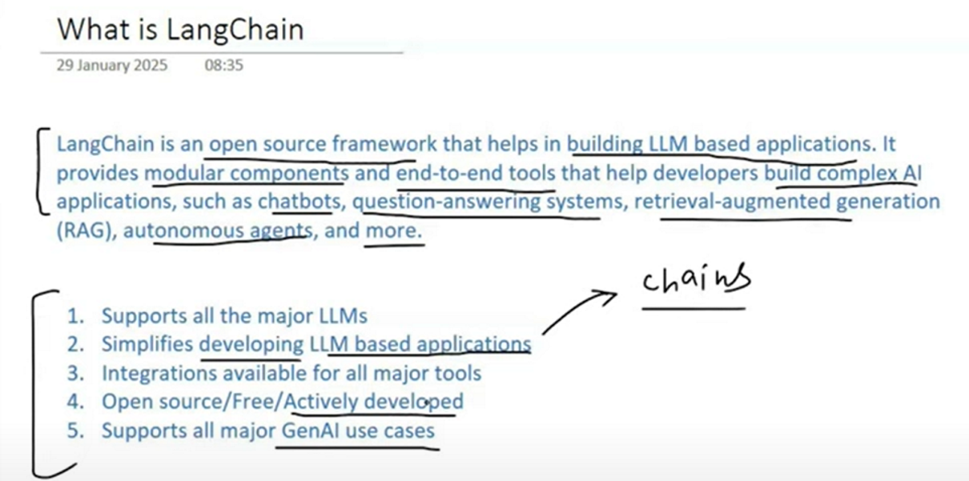
LangChain is an open-source framework for developing applications powered by Large Language Models (LLMs).

